Slide 1

How does the web work?
This Photo by Unknown author is licensed under CC BY-NC.

Slide 2
Client Server Architecture
The web operates on a client-server architecture, dividing responsibilities between the client (web browser) and the server (hosting resources).
Clients initiate requests for web content, while servers process those requests, generate responses, and send them back to the clients.
The client-server model enables workload distribution, specialization of tasks, and effective communication through the request-response paradigm.
Additional components and technologies such as HTTP, DNS, web browsers, and development frameworks contribute to the web's overall architecture and functionality.
This architecture allows users to access and interact with information on the web through their browsers, while servers handle the storage, processing, and delivery of resources.

Slide 3
Breakdown of a simple web request
URL Parsing: When a user enters a web address or clicks on a link, the web browser parses the URL to extract the relevant components. These components include the protocol (HTTP or HTTPS), domain name (e.g., www.example.com), and the path to the specific resource.
DNS Lookup: The browser needs to resolve the domain name (e.g., www.example.com) to an IP address, which is done through the Domain Name System (DNS). The browser sends a DNS lookup request to a DNS server, typically provided by the user's Internet Service Provider (ISP) or a public DNS service like Google DNS.
Establishing a TCP/IP Connection: Once the browser knows the IP address of the server, it establishes a TCP/IP connection. TCP (Transmission Control Protocol) is responsible for reliable transmission of data, and IP (Internet Protocol) handles the routing of packets across the internet.
Three-Way Handshake: Before the actual data transfer can begin, a three-way handshake is performed to establish a connection. The client browser sends a SYN (synchronize) packet to the server, indicating its desire to initiate a connection. The server responds with a SYN-ACK (synchronize-acknowledge) packet, acknowledging the request and providing its own SYN value. Finally, the client sends an ACK packet, acknowledging the server's response.

Slide 4
HTTP Request: With the TCP/IP connection established, the browser sends an HTTP request to the server. The request contains the method (e.g., GET, POST), the requested resource's path, headers (including user agent information, cookies, and more), and possibly additional data (e.g., form submissions).
Routing and Data Transmission: The server receives the HTTP request and processes it. The response generated by the server travels back to the client over the established TCP/IP connection. The response includes the requested resource (e.g., HTML, images, CSS, JavaScript) and relevant metadata.
HTTP Response: The browser receives the HTTP response from the server, which includes a status code indicating the success or failure of the request (e.g., 200 for OK, 404 for Not Found). The response also contains the requested data and additional headers.
Rendering: Once the browser receives the response, it interprets the received data. The browser parses the HTML to construct the document structure, applies CSS styles for visual presentation, executes any embedded or referenced JavaScript code for interactivity, and loads any additional resources (e.g., images, videos) referenced in the HTML.

Slide 5
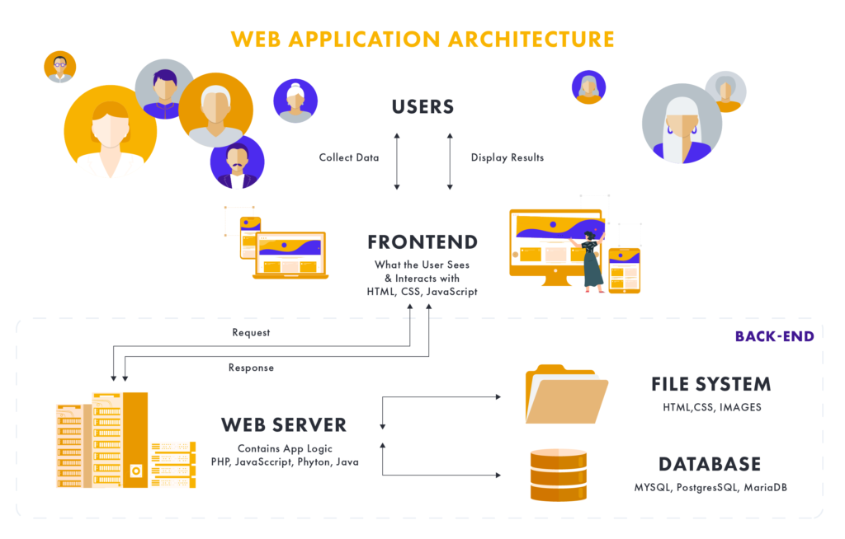

Slide 6
Client Side (Front end)
Client-side refers to the part of web development that focuses on the user's browser and device.
Client-side technologies like HTML, CSS, and JavaScript enable the presentation, styling, and interactivity of web pages.
User interactions, such as form submissions or UI events, are handled on the client-side, reducing the need for server communication.
Client-side code runs on the user's device, allowing for faster response times and enhanced user experiences.
Client-side frameworks and libraries like React, Angular, and Vue.js simplify the development of interactive web applications.

Slide 7
Server Side (Backend)
Server-side refers to the part of web development that takes place on the web server.
Server-side technologies, such as programming languages like Python, Java, PHP, or Node.js, handle data processing, business logic, and server-side operations.
Servers store and manage databases, handle authentication, and generate dynamic content for the client.
Server-side code interacts with databases, processes form data, and generates dynamic web pages based on client requests.
Server-side frameworks and platforms like Django, Ruby on Rails, ASP.NET, and Express.js provide tools and structures to streamline server-side development.

Slide 8
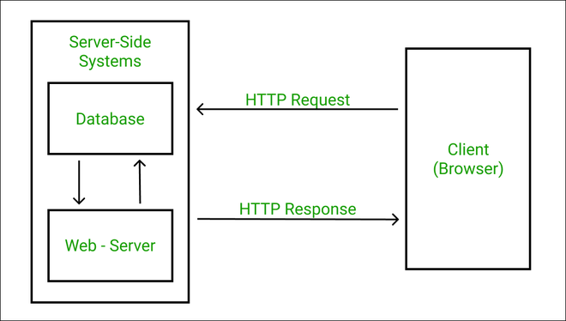
Request Response Cycle
HTTP (Hypertext Transfer Protocol) is a protocol that governs the communication between a client (such as a web browser) and a server. HTTP requests and responses play a crucial role in this communication process.

Slide 9
HTTP Request
An HTTP request is initiated by the client to retrieve a resource from the server. It consists of several components:
Request method: Specifies the action to be performed on the resource (e.g., GET, POST, PUT, DELETE).
URL (Uniform Resource Locator): Identifies the location of the resource on the server.
Query parameters: Additional data appended to the URL for specific request requirements.
Headers: Additional information accompanying the request, such as user agent, cookies, or content type.
Body (optional): Contains data sent to the server, typically used in POST or PUT requests.
Examples of common request methods include:
GET: Retrieves a resource from the server.
POST: Submits data to be processed by the server, often used for form submissions.
PUT: Updates a resource on the server.
DELETE: Removes a resource from the server.

Slide 10
HTTP Response
An HTTP response is generated by the server in response to a client's request. It consists of multiple parts:
Status line: Provides information about the response status, including a status code (e.g., 200 for success, 404 for not found).
Headers: Additional metadata accompanying the response, such as content type, cache directives, or cookies.
Body: Contains the requested resource or error message sent from the server.
Examples of common status codes include:
200 OK: The request was successful, and the response contains the requested resource.
404 Not Found: The requested resource could not be found on the server.
500 Internal Server Error: The server encountered an error while processing the request.
302 Found: The requested resource has moved temporarily to a different location.

Slide 11
